Slide 1
Chapter 1
Introduction to computer network
Notes:
1.#

Slide 2
Topics
Introduction to computer network
Network applications
Network software and hardware components (Interconnection networking devices)
Network topology
protocol hierarchies
Design issues for the layers
Connection oriented and connectionless services

Slide 3
Modern world scenario is ever changing.
Data Communication and network have changed the way business and other daily affair works.
Now, they highly rely on computer networks and internetwork.

Slide 4
What is Computer network?
A computer network is a group of computer systems and other computing hardware devices that are linked together through communication channels to facilitate communication and resource- sharing among a wide range of users.

Slide 5
Network Criteria
Performance
  Depends on Network Elements
  Measured in terms of Delay and Throughput
Reliability
  Failure rate of network components
  Measured in terms of availability/robustness
Security
  Data protection against corruption/loss of data due to:
      Errors
      Malicious users
Notes:
1.#

Slide 6
Properties of a Good Network
Interpersonal Communication: We can communicate with each other efficiently and easily. Example: emails, chat rooms, video conferencing etc, all of these are possible because of computer networks.
Resources can be shared: We can share physical resources by making them available on a network such as printers, scanners etc.
Sharing files, data: Authorised users are allowed to share the files on the network.

Slide 7
Basic Communication Model
A Communication model is used to exchange data between two parties. For example: communication between a computer, server and telephone (through modem).

Slide 8
Communication Model: Source
Data to be transmitted is generated by this device, example: telephones, personal computers etc.
Communication Model: Transmitter
The data generated by the source system is not directly transmitted in the form its generated. The transmitter transforms and encodes the data in such a form to produce electromagnetic waves or signals.
Communication Model: Transmission System
A transmission system can be a single transmission line or a complex network connecting source and destination.
Communication Model: Receiver
Receiver accepts the signal from the transmission system and converts it into a form which is easily managed by the destination device.
Communication Model: Destination
Destination receives the incoming data from the receiver.

Slide 9
Applications/Uses of computer Network
Business Applications
Home Applications
Mobile Users

Slide 10
Business Application
Resource Sharing
Client Sever Model
Communication medium
E commerce
1.<number>

Slide 11
Resource Sharing
The goal is to make all programs, equipments(like printers etc), and especially data, available to anyone on the network without regard to the physical location of the resource and the user.
1.<number>

Slide 12
Client Server Model
One can imagine a company's information system as consisting of one or more databases and some employees who need to access it remotely.
In this model, the data is stored on powerful computers called Servers.
Often these are centrally housed and maintained by a system administrator. In contrast, the employees have simple machines, called Clients, on their desks, using which they access remote data.
1.<number>

Slide 13
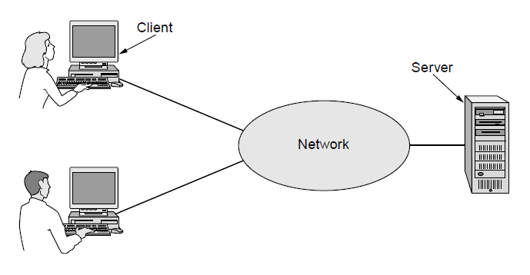
Business Applications (1)
A network with two clients and one server

Slide 14
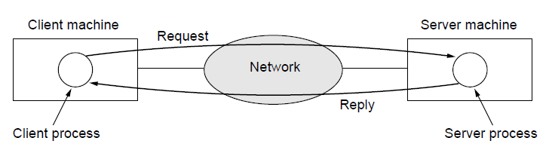
Business Applications (2)
The client-server model involves requests and replies

Slide 15
Communication Medium
A computer network can provide a powerful communication medium among employees.
Virtually every company that has two or more computers now has e-mail (electronic mail), which employees generally use for a great deal of daily communication

Slide 16
E - Commerce:
A goal that is starting to become more important in businesses is doing business with consumers over the Internet.
Airlines, bookstores and music vendors have discovered that many customers like the convenience of shopping from home. This sector is expected to grow quickly in the future.

Slide 17
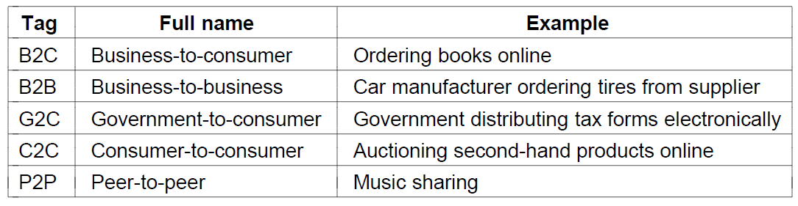

Slide 18
Home Applications
Access to remote information
Person-to-person communication
Interactive entertainment
Electronic commerce

Slide 19
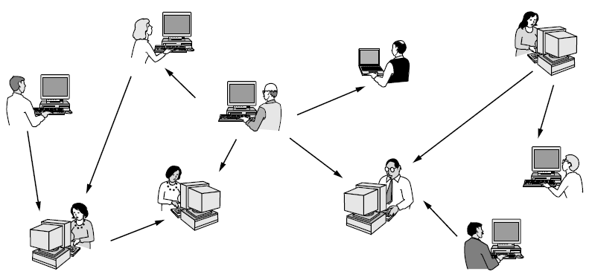
Home Applications (1)
In a peer-to-peer system there are no fixed clients and servers.

Slide 20
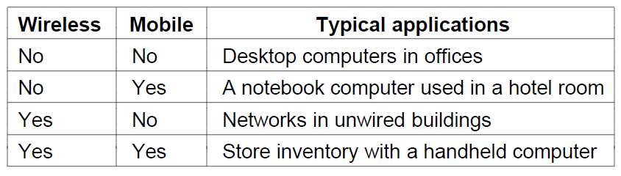
Mobile Users
Mobile computers, such as notebook computers and Mobile phones, is one of the fastest-growing segment of the entire computer industry. Although wireless networking and mobile computing are often related, they are not identical, as the below figure shows.
Combinations of wireless networks and mobile computing

Slide 21
Line Configuration in Computer Networks
A Network is nothing but a connection made through connection links between two or more devices.
Devices can be a computer, printer or any other device that is capable to send and receive data. There are two ways to connect the devices :
  Point-to-Point connection
  Multipoint connection

Slide 22
Point-To-Point Connection
It is a protocol which is used as a communication link between two devices. It is simple to establish. The most common example for Point-to-Point connection (PPP) is a computer connected by telephone line. We can connect the two devices by means of a pair of wires or using a microwave or satellite link.
Example: Point-to-Point connection between remote control and Television for changing the channels.

Slide 23
MultiPoint Connection
It is also called Multidrop configuration. In this connection two or more devices share a single link.
There are two kinds of Multipoint Connections :
If the links are used simultaneously between many devices, then it is spatially shared line configuration.
2. If user takes turns while using the link, then it is time shared (temporal) line configuration.

Slide 24

Types of connections: point-to-point and multipoint
Notes:
1.#

Slide 25
Types of Network Topology
Network topology refers to the physical or logical layout of a network.
It defines the way different nodes are placed and interconnected with each other.
Alternately, network topology may describe how the data is transferred between these nodes.

Slide 26
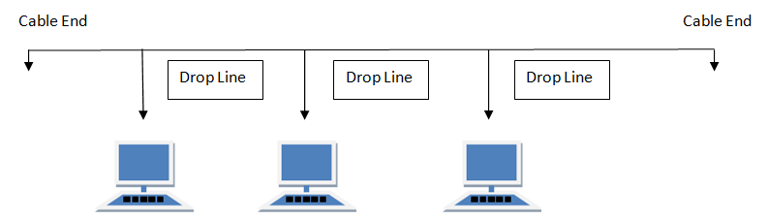
BUS Topology
Bus topology is a network type in which every computer and network device is connected to a single cable. When it has exactly two endpoints, then it is called Linear Bus topology.

Slide 27
Features of Bus Topology
It transmits data only in one direction.
Every device is connected to a single cable
Advantages of Bus Topology
It is cost effective.
Cable required is least compared to other network topology.
Used in small networks.
It is easy to understand.
Easy to expand joining two cables together.
Disadvantages of Bus Topology
Cables fails then whole network fails.
If network traffic is heavy or nodes are more the performance of the network decreases.
Cable has a limited length.
It is slower than the ring topology.

Slide 28
RING Topology
It is called ring topology because it forms a ring as each computer is connected to another computer, with the last one connected to the first.
Exactly two neighbours for each device.

Slide 29
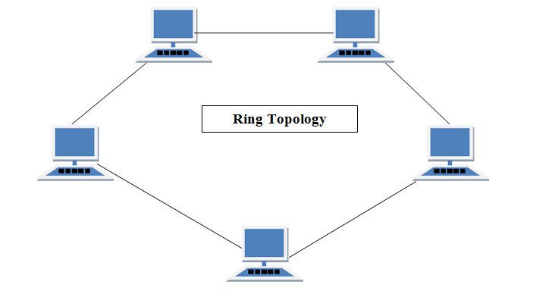

Slide 30
Features of Ring Topology
A number of repeaters are used for Ring topology with large number of nodes, because if someone wants to send some data to the last node in the ring topology with 100 nodes, then the data will have to pass through 99 nodes to reach the 100th node. Hence to prevent data loss repeaters are used in the network.
The transmission is unidirectional, but it can be made bidirectional by having 2 connections between each Network Node, it is called Dual Ring Topology.
In Dual Ring Topology, two ring networks are formed, and data flow is in opposite direction in them. Also, if one ring fails, the second ring can act as a backup, to keep the network up.
Data is transferred in a sequential manner that is bit by bit. Data transmitted, has to pass through each node of the network, till the destination node.

Slide 31
Advantages of Ring Topology
Transmitting network is not affected by high traffic or by adding more nodes, as only the nodes having tokens can transmit data.
Cheap to install and expand
Disadvantages of Ring Topology
Troubleshooting is difficult in ring topology.
Adding or deleting the computers disturbs the network activity.
Failure of one computer disturbs the whole network.

Slide 32
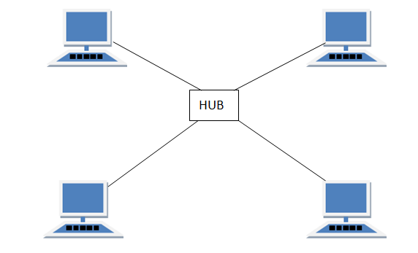
STAR Topology
In this type of topology all the computers are connected to a single hub through a cable. This hub is the central node and all others nodes are connected to the central node.

Slide 33
Features of Star Topology
Every node has its own dedicated connection to the hub.
Hub acts as a repeater for data flow.
Can be used with twisted pair, Optical Fibre or coaxial cable.
Advantages of Star Topology
Fast performance with few nodes and low network traffic.
Hub can be upgraded easily.
Easy to troubleshoot. Fault isolation is easy.
Easy to setup and modify.
Only that node is affected which has failed, rest of the nodes can work smoothly.
Disadvantages of Star Topology
Cost of installation is high.
Expensive to use.
If the hub fails then the whole network is stopped because all the nodes depend on the hub.
Performance is based on the hub that is it depends on its capacity

Slide 34
MESH Topology
It is a point-to-point connection to other nodes or devices. All the network nodes are connected to each other. Mesh has n(n-1)/2 physical channels to link n devices.

Slide 35

A fully connected mesh topology (five devices)
Notes:
1.#

Slide 36
Types of Mesh Topology
Partial Mesh Topology :
In this topology some of the systems are connected in the same fashion as mesh topology but some devices are only connected to two or three devices.
Full Mesh Topology :
Each and every nodes or devices are connected to each other.
Features of Mesh Topology
Fully connected.
Robust.
Not flexible.

Slide 37
Advantages of Mesh Topology
Each connection can carry its own data load.
It is robust.
Fault is diagnosed easily.
Provides security and privacy.
Disadvantages of Mesh Topology
Installation and configuration is difficult.
Cabling cost is more.
Bulk wiring is required.

Slide 38
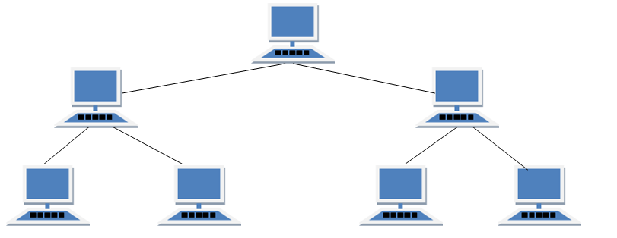
TREE Topology
It has a root node and all other nodes are connected to it forming a hierarchy. It is also called hierarchical topology. It should at least have three levels to the hierarchy.

Slide 39
Features of Tree Topology
Ideal if workstations are located in groups.
Used in Wide Area Network.
Advantages of Tree Topology
Extension of bus and star topologies.
Expansion of nodes is possible and easy.
Easily managed and maintained.
Error detection is easily done.
Disadvantages of Tree Topology
Heavily cabled.
Costly.
If more nodes are added maintenance is difficult.
Central hub fails, network fails.

Slide 40
HYBRID Topology
It is two different types of topologies which is a mixture of two or more topologies. For example if in an office in one department ring topology is used and in another star topology is used, connecting these topologies will result in Hybrid Topology (ring topology and star topology).

Slide 41
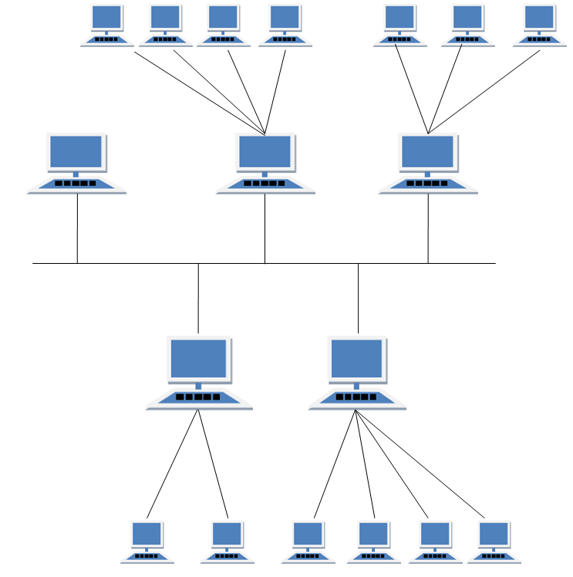
Hybrid Topology

Slide 42
Features of Hybrid Topology
It is a combination of two or topologies
Inherits the advantages and disadvantages of the topologies included
Advantages of Hybrid Topology
Reliable as Error detecting and trouble shooting is easy.
Effective.
Scalable as size can be increased easily.
Flexible.
Disadvantages of Hybrid Topology
Complex in design.
Costly.

Slide 43
Protocol Hierarchies (1)
To reduce the design complexity , most networks are organized as a stack of layers.
The number of layers, the name of each layer, content of each layer and the functions of each layer differ from network to network.
The purpose of each layer is to offer some services to the layer above it, shielding those layers from the details of how these services are actually implemented.
This is the concept of data hiding or data abstraction in terms of OOPM.

Slide 44
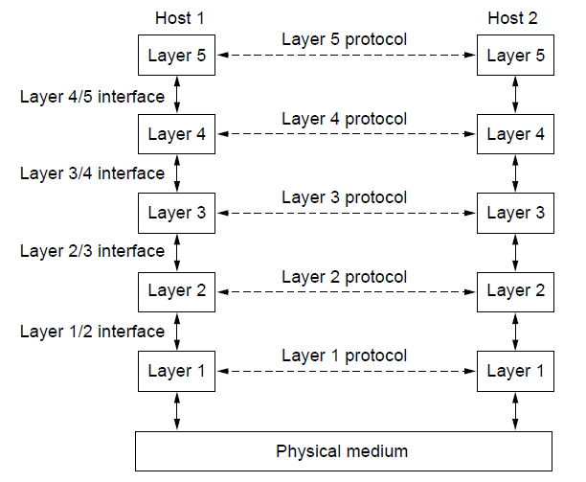
Protocol Hierarchies (2)
Layers, protocols, and interfaces.

Slide 45
Protocol Hierarchies(3)
The layer n on one machine carries a conversation with layer n on another machine.
The rules and conventions used in this conversation are collectively known as the layer n protocol.
A protocol is an agreement between the communicating parties on how the communication is to proceed.
The entities comprising the corresponding layers on different machines are called peers. The peers may be processes, hardware devices or even a user.
Its peers that communicate using protocols.

Slide 46
Protocol Hierarchies(4)
In Reality no data is transferred from layer n on one machine to layer n on another machine.
Each layer passes data and control information to the layer immediately below it, until the lowest layer is reached.
Below layer1 is the physical medium through which actual communication occurs.
Between each pair of adjacent layers is an interface.
The interface defines which primitive operations and services the lower layer makes available to the upper one.
Most important consideration is defining clean interfaces between the layers.

Slide 47
Protocol Hierarchies(5)
A set of layers and protocols is called network architecture.
The specification of architecture must include enough information to allow implementer to write the programs or build the hardware.
Neither the details of the implementation nor the specifications of the interface is part of the network architecture.
A list of protocols used by a certain system, one protocol per layer, is called a protocol stack.

Slide 48
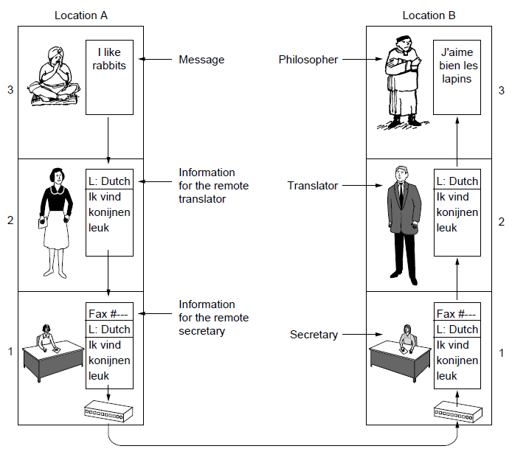
Protocol Hierarchies (6)
The philosopher-translator-secretary architecture

Slide 49
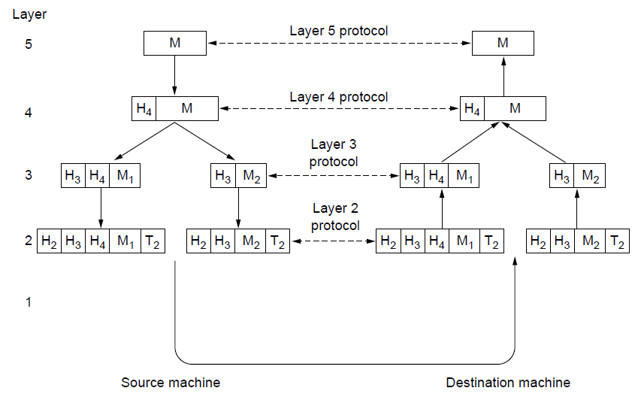
Protocol Hierarchies (7)
Example information flow supporting virtual
communication in layer 5.

Slide 50
Protocol Hierarchies(8)
Message is generated by the application of the source machine.
Message will be sent from the source to the destination.
Message “M” is transferred from layer 5 to layer 4, with a header containing control information, such as sequence numbers, which helps layer 4 maintain the message order.
Layer 3 break the message from layer 4 into two pieces to fit the transmission restrictions, while adding another header to tell layer 2 where the dest. is.
Layer 2 adds the messages from layer 3 with another header, telling the actual (physical) address of the dest, and a trailer, which is the checksum of the message for correction assertion.
At the receiving machine the message moves upward, from layer to layer, with headers being stripped off as it progresses. Message is sent to the dest. machine.

Slide 51
Design Issues for the Layers(1)
Addressing: Some mechanism is needed to identify sender and receiver. A machine can run multiple processes, a means is needed for a process on one machine to specify with whom it wants to talk. Some form of addressing is needed in order to specify specific destination.
Error Control: Physical communication circuits are not perfect. Both the ends must agree upon error- correcting code to be used during conversation. Also the receiver must have some way of telling the sender which messages have been correctly received and which have not.
Preserving of message ordering: To deal with possible loss of sequencing , the protocol must make explicit provision for the receiver to allow the pieces to be reassembled properly. An obvious solution is to number the pieces.

Slide 52
Design Issues for the Layers(2)
Flow control: How to keep a fast sender from swamping slow receiver with data? Some kind of feedback from the receiver can be provided to the sender about the receiver’s current situation. The sender can adjust its packet sending rate accordingly.
Handling Large messages: Not all processes cab accept arbitrarily long messages. This property leads to the mechanism of disassembling, transmitting and reassembling messages.

Slide 53
Design Issues for the Layers(3)
Multiplexing/ De multiplexing: When it is expensive to set up a separate connection for each pair of communicating processes, the underlying layer may decide to use the same connection for multiple , unrelated conversations. This is called multiplexing. Multiplexing and De multiplexing has to be done transparently.
Routing: When there are multiple paths between source and destination, a route must be chosen. This is called routing.

Slide 54
Connection – Oriented and Connectionless service
Layers can offer two different types of services to the layer above it.
Connection-oriented
Connection less

Slide 55
Connection Oriented Service(1)
Modeled after the telephone system.
Three steps
establish a connection
use the connection
release the connection
Here the connection acts like a tube. The sender pushes objects (bits) at one end and the receiver takes them out at the other end.
The order is preserved.
It is possible to negotiate parameters while establishing connections. Usually one side makes proposal , and other side accepts it, rejects it or makes a counter proposal.

Slide 56
Connection less services
Modeled after postal system.
Each message carries the full destination address and each one is routed through the system independent of all the others.
Order may not preserved.

Slide 57
Quality of service
Reliable
Un Reliable

Slide 58
Quality Of service(1)
Reliable:
They never loses data.
Reliable service is implemented by having the receiver acknowledge the receipt of each message to the sender.
The acknowledgement process introduces overhead of delays which are often with but sometime undesirable.

Slide 59
Quality Of service(2)
Unreliable service
No acknowledgements sent
Best effort delivery
They are often called datagram services

Slide 60
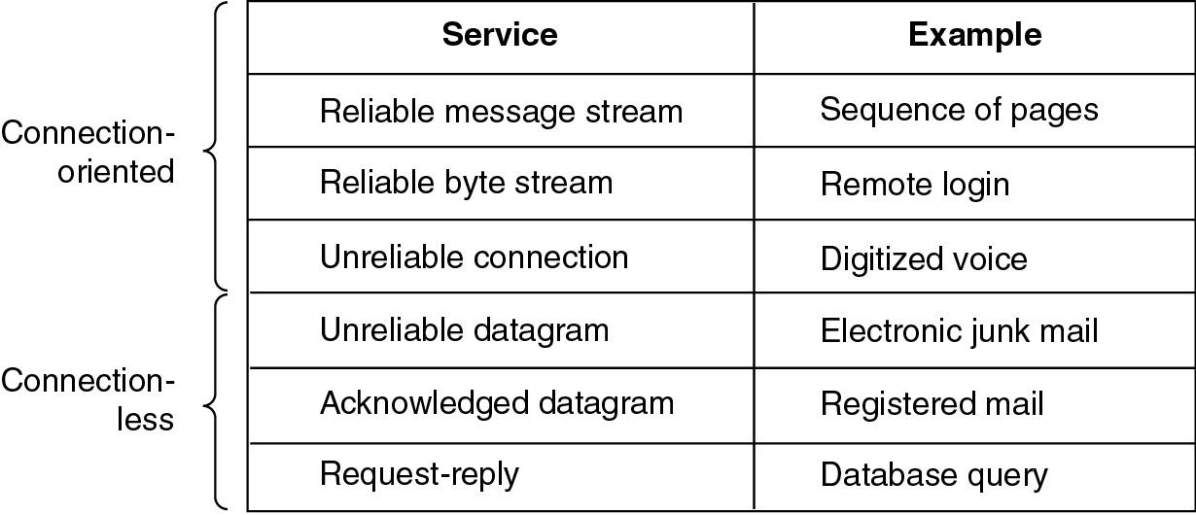
Six different types of services

Slide 61
Service Primitives
A service is specified by a set of primitives (operations) available to user process to access service.
These primitives tell the service to perform some action or report to an action or report on an action taken by a peer entity.
If the protocol stack is implemented in the OS then primitives are normally system calls. These calls cause a trap to the kernel mode, which then turns control of the machine over to the OS to send the necessary packet.
The primitives for connection-oriented service are different than those of the connection less service.

Slide 62
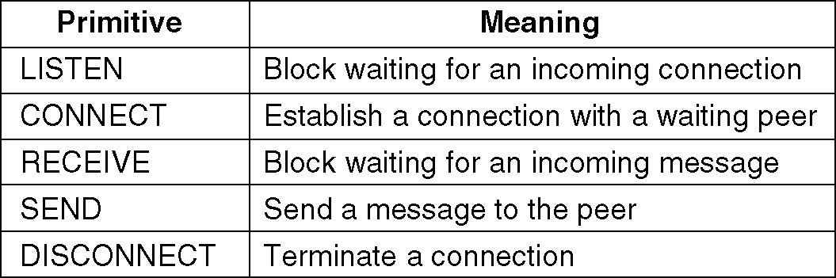
Service Primitives
Service Primitives for connection-oriented service
Connect.request |  | Connect.indication
Connect.confirm
Data.request |  | Data.indication
Data.indication |  | Data.request
Disconnect.request |  | Disconnect.indication
Disconnect.confirm

Slide 63
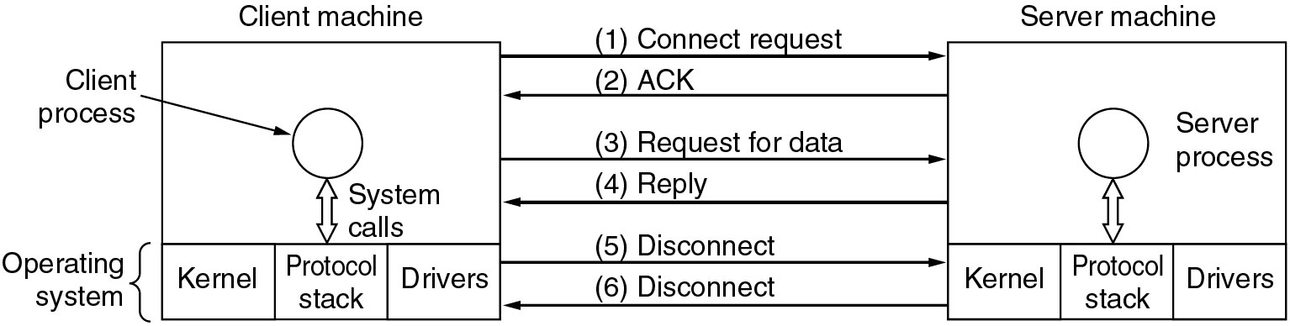
Example Connection -oriented

Slide 64
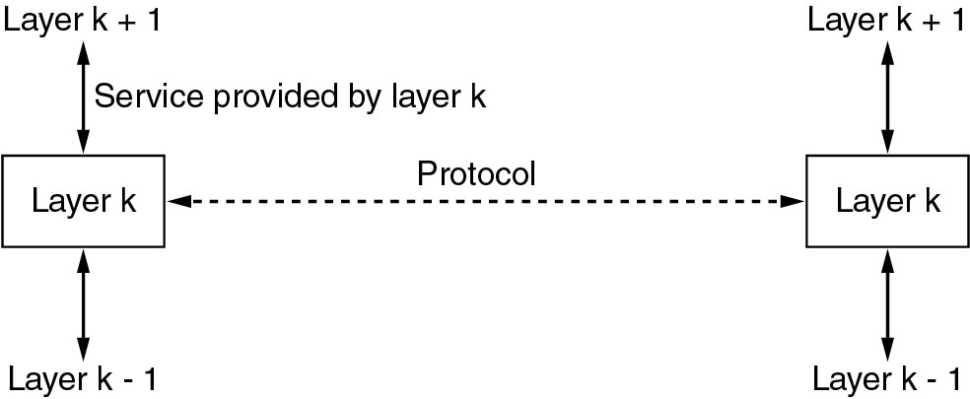
Services to Protocols Relationship
Services are primitives that a layer provides for the layer above it.
The service defined what operations the layer is prepared to performed
Protocols are rules governing the meaning of frames/packets/messages exchanged with the peer entity.

Slide 65
OSI Reference Model

Slide 66
Reference Models
  OSI reference model
    developed by the International Standards Organization (ISO)
    OSI means Open Systems Interconnection
    It is rarely used today, while it is actually quite general and still valid, and the features discussed at each layer are still very important.
    OSI model itself is not a network architecture because it does not specify the exact services and protocols to be used in each layer.
  TCP/IP reference model.
    developed by ARPANET
    Used to construct the Internet today
    However, the model itself is not of much use

Slide 67
Principles used for creating seven layers
A layer should be created where a different abstraction is needed.
Each layer should perform a well-defined function.
The function of each layer should be chosen with an eye toward defining internationally standardized protocols
The layer boundaries should be chosen to minimize the information flow across the interfaces.
The number of layers should be large enough that distinct functions need not to be put together in the same layer and small enough that the architecture does not become unwieldy.

Slide 68
OSI Reference Model
The OSI model is now considered the primary Architectural model for inter-computer communications.
The OSI model describes how information or data makes its way from application programmes (such as spreadsheets) through a network medium (such as wire) to another application programme located on another network.
The OSI reference model divides the problem of moving information between computers over a network medium into SEVEN smaller and more manageable problems .
This separation into smaller more manageable functions is known as layering.

Slide 69
Physical Layer
OSI Model
Provides physical interface for transmission of information.
Defines rules by which bits are passed from one system to another on a physical communication medium.
Covers all - mechanical, electrical, functional and procedural - aspects for physical communication.
Such characteristics as voltage levels, timing of voltage changes, physical data rates, maximum transmission distances, physical connectors, and other similar attributes are defined by physical layer specifications.

Slide 70
Data Link Layer
OSI Model
Data link layer attempts to provide reliable communication over the physical layer interface.
Breaks the outgoing data into frames and reassemble the received frames.
Create and detect frame boundaries.
Handle errors by implementing an acknowledgement and retransmission scheme.
Implement flow control.
Supports points-to-point as well as broadcast communication.
Supports simplex, half-duplex or full-duplex communication.

Slide 71
Network Layer
OSI Model
Implements routing of frames (packets) through the network.
Defines the most optimum path the packet should take from the source to the destination
Defines logical addressing so that any endpoint can be identified.
Handles congestion in the network.
Facilitates interconnection between heterogeneous networks (Internetworking).
The network layer also defines how to fragment a packet into smaller packets to accommodate different media.

Slide 72
Transport Layer
OSI Model
Purpose of this layer is to provide a reliable mechanism for the exchange of data between two processes in different computers.
Ensures that the data units are delivered error free.
Ensures that data units are delivered in sequence.
Ensures that there is no loss or duplication of data units.
Provides connectionless or connection oriented service.
Provides for the connection management.
Multiplex multiple connection over a single channel.

Slide 73
Session Layer
OSI Model
/Session layer provides mechanism for controlling the dialogue between the two end systems. It defines how to start, control and end conversations (called sessions) between applications.
This layer requests for a logical connection to be established on an end-user’s request.
Any necessary log-on or password validation is also handled by this layer.
Session layer is also responsible for terminating the connection.
This layer provides services like dialogue discipline which can be full duplex or half duplex.
Session layer can also provide check-pointing mechanism such that if a failure of some sort occurs between checkpoints, all data can be retransmitted from the last checkpoint.

Slide 74
Presentation Layer
OSI Model
Presentation layer defines the format in which the data is to be exchanged between the two communicating entities.
Also handles data compression and data encryption (cryptography).

Slide 75
Application Layer
OSI Model
Application layer interacts with application programs and is the highest level of OSI model.
Application layer contains management functions to support distributed applications.
Examples of application layer are applications such as file transfer, electronic mail, remote login etc.

Slide 76
The TCP/IP Reference Model

Slide 77
Overview of TCP/IP reference model
A majority of the internet uses a protocol suite called the Internet Protocol Suite also known as the TCP/IP protocol suite.
This suite is a combination of protocols which encompasses a number of different protocols for different purpose and need.
Because the two major protocols in this suites are TCP (Transmission Control Protocol) and IP (Internet Protocol), this is commonly termed as TCP/IP Protocol suite.
This protocol suite has its own reference model which it follows over the internet.
In contrast with the OSI model, this model of protocols contains less layers. (4 layers)

Slide 78
Overview of TCP/IP reference model(1)
This model is indifferent to the actual hardware implementation, i.e. the physical layer of OSI Model.
This is why this model can be implemented on almost all underlying technologies.
Transport and Internet layers correspond to the same peer layers.
All three top layers of OSI Model are compressed together in single Application layer of TCP/IP Model.

Slide 79
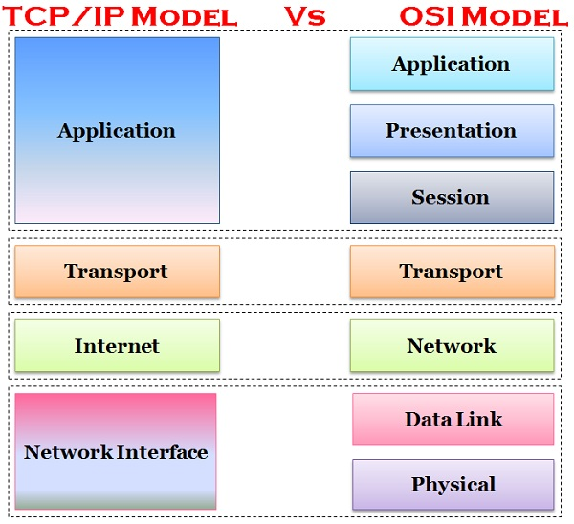
The TCP/IP Model

Slide 80
Layer 1: Host-to-network Layer
This layer corresponds to the combination of Data Link Layer and Physical Layer of the OSI model.
The model does not talk much about this layers, except to point out that the host has to connect to the network using some protocol so that it can send IP packets to it.
This protocol is not defined and varies from host to host and network to network.

Slide 81
Layer 2: Internet layer
This layer corresponds to the network layer of the OSI model.
This layer is essentially a packet switching network based on connection less service.
It is the layer which holds the whole architecture together.
It helps the packet to travel independently to the destination.
Order in which packets are received is different from the way they are sent.
IP (Internet Protocol) is used in this layer.
The various functions performed by the Internet Layer are:
  Delivering IP packets
  Performing routing
  Avoiding congestion

Slide 82
Layer 3: Transport Layer
Transport layer also known as Host-To-Host layer ,is analogous to the transport layer of the OSI model.
It is responsible for end-to-end communication and error-free delivery of data.
It shields the upper-layer applications from the complexities of data.
The two main protocols present in this layer are :
Transmission Control Protocol (TCP) –
It is known to provide reliable and error-free communication between end systems.
It performs sequencing and segmentation of data.
It also has acknowledgement feature and controls the flow of the data through flow control mechanism.
It is a very effective protocol but has a lot of overhead due to such features. Increased overhead leads to increased cost.
User Datagram Protocol (UDP) –
On the other hand UDP does not provide any such features.
It is the go to protocol if your application does not require reliable transport as it is very cost-effective.
Unlike TCP, which is connection-oriented protocol, UDP is connectionless.

Slide 83
Layer 4: Application Layer
This layer performs the functions of top three layers of the OSI model: Application, Presentation and Session Layer.
It is responsible for node-to-node communication and controls user-interface specifications.
Some of the protocols present in this layer are : HTTP, HTTPS, FTP, TFTP, Telnet, SSH, SMTP, SNMP, NTP, DNS, DHCP, NFS, X Window, LPD.
TELNET is a two-way communication protocol which allows connecting to a remote machine and run applications on it.
FTP(File Transfer Protocol) is a protocol, that allows File transfer amongst computer users connected over a network. It is reliable, simple and efficient.
SMTP(Simple Mail Transport Protocol) is a protocol, which is used to transport electronic mail between a source and destination, directed via a route.
DNS(Domain Name Server) resolves an IP address into a textual address for Hosts connected over a network.

Slide 84
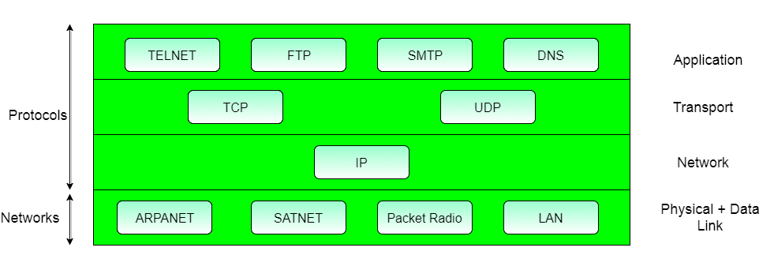
The TCP/IP Model (1)

Slide 85
OSI VS. TCP/IP
 | OSI | TCP/IP
1 | OSI reference model is a generic , protocol independent model. | The TCP/IP is based on the standard protocols.
2 | Three concept are central to the OSI model- services, interfaces, protocols | The TCP/IP model originally did not clearly distinguish between service, interface and protocols.
3 | The OSI reference model was designed before the corresponding protocols were invented. This means that the model is not biased towards any protocol. (protocol independent) | With TCP/IP , the protocol came first and the model was just a description of existing protocols. There is no problems with the protocol fitting the model. But the problem with this is the model did not fit any other protocol stack.(protocol dependent)
4 | It has 7 layers. It has separate presentation and session layers. | It has 4 layers. It combines session and presentation layer into application layer.
5 | The OSI model supports both connection oriented and connection less communication at network layer but only connection oriented service at transport layer | The TCP / IP has only one mode in the network layer (connection less communication) but supports both modes (connection less and connection-oriented) in the transport layer.
6 | The OSI follows vertical approach | TCP/IP follows horizontal approach
7 | OSI is a reference model around which the networks are built. Generally it is used as a guidance tool. | TCP/IP model is, in a way implementation of the OSI model.

Slide 86
Internetworking Devices

Slide 87
Inter Networking Devices
An internetworking device is a widely-used term for any hardware within networks that connect different network resources.
As computer networks grow in size and complexity, so do the internetworking devices used to connect them.

Slide 88
Purpose
They allow a greater number of nodes to be connected to the network.
They extend the distance over which a network can extend.
They localize traffic on the network.
They can merge existing networks.
They isolate network problems so that they can be diagnosed more easily.

Slide 89
Inter Networking Devices(1)
Repeaters
Hub
Bridges
Switches
Router
Gateways
Modems
NIC

Slide 90
Repeaters
When an information-bearing signal passes through a communication channel, it is progressively degraded due to loss of power.
The longer the distance is, the more power is lost.
A repeater is a network device that regenerates the weak signal.
It is used to expand the coverage area of the network, re-propagate a weak or broken signal.
It is a 2 port device.
Repeaters operate at Physical layer of the OSI model.

Slide 91
Hubs
A Hub is basically a multi port repeater.
Hubs are mostly used in a star topology as a central connecting point, at the same time it regenerates the weak signal.
Hubs cannot filter data, this means data packets are sent to all connected devices except the incoming line.
In other words, collision domain of all hosts connected through Hub remains one.
Also, they do not have intelligence to find out best path for data packets which leads to inefficiencies and wastage.
Hubs operate at physical layer of OSI model.

Slide 92
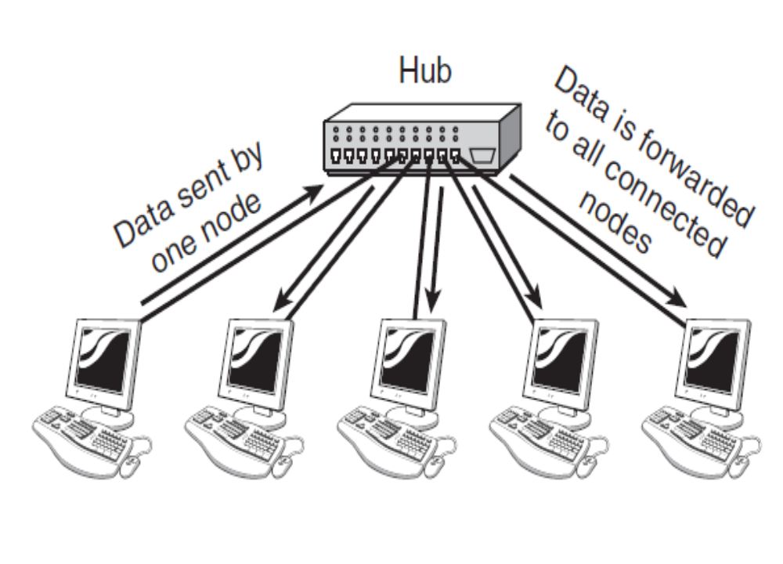

Slide 93
Types of Hubs
Active Hub :- These are the hubs which have their own power supply and can clean , boost and relay the signal along the network. It serves both as a repeater as well as wiring center. These are used to extend maximum distance between nodes.
Passive Hub :- These hubs relay signals onto the network without cleaning and boosting them and can’t be used to extend distance between nodes.

Slide 94
Bridge
A bridge operates at physical layer and data link layer.
Being a physical layer device, it regenerates the signal it receives. Here, it acts as a repeater.
Being a link layer device it has a capability of filtering content by reading the MAC addresses of source and destination.
Bridges are usually used to connect fewer network segments.
Simple bridges have only two ports , so they can connect only two network segments.
There are multiport bridges available that can connect more than two network segments.

Slide 95
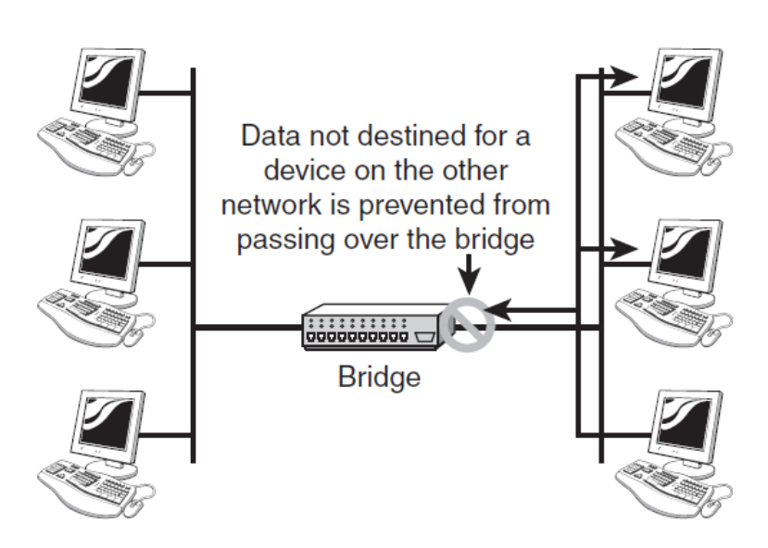
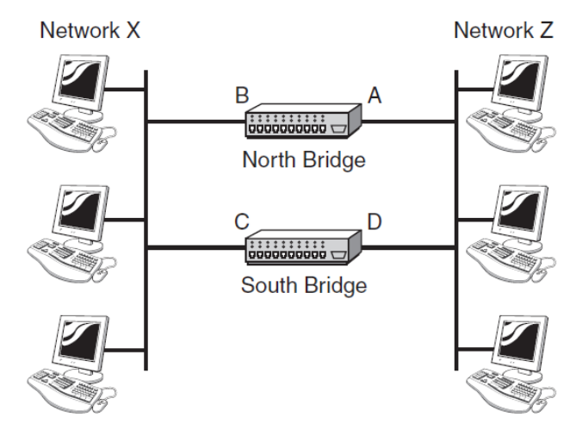
How bridge work?
A network with two bridges

Slide 96
Types of Bridges
Transparent Bridges :- These are the bridge in which the stations are completely unaware of the bridge’s existence i.e. whether or not a bridge is added or deleted from the network , reconfiguration of
the stations is unnecessary.
Source Routing Bridges :- In these bridges, routing operation is performed by source station and the frame specifies which route to follow.

Slide 97
Switches
Switches are similar to bridges but they have faster forwarding capabilities and greater efficiency.
They also operate in both the physical and the data-link layers.
It can connect multiple network segments.
As a link–layer device, it can check MAC addresses contained in the frame.
It has a filtering capabilities. It can check the destination address of a frame and can decide to which out going line the frame has to be sent.
It creates a table that is used for filtering decisions.
A switch has a buffer for the each link connected to it. Here, the receiving link buffers, store the packet and check for the outgoing link. If the outgoing link is free, switch sends the packet onto the outgoing link.

Slide 98
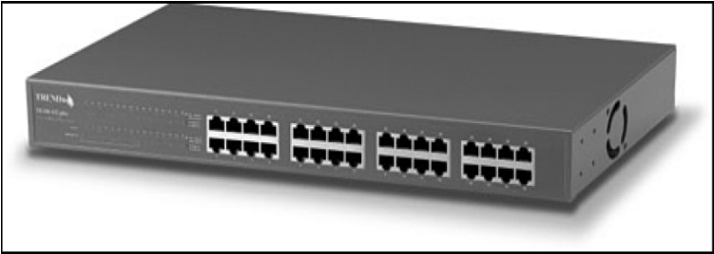
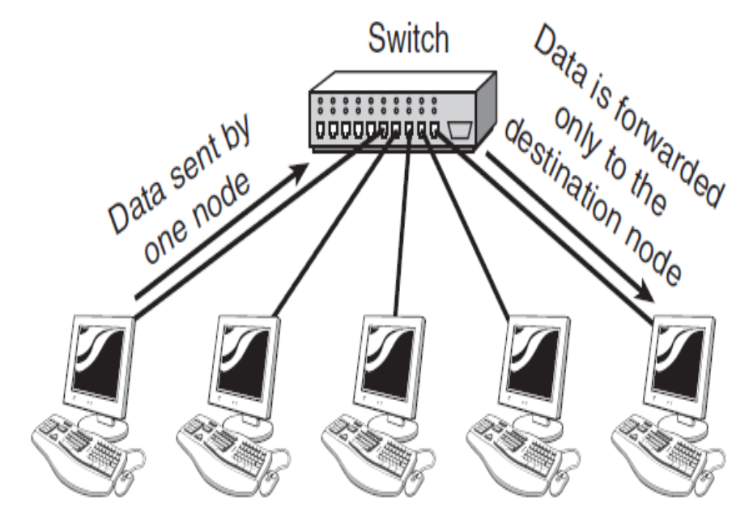
Switch
A 32-port Ethernet switch.

Slide 99
Difference between Switch and Bridge
The difference between switches and bridges:
Bridges generally connect fewer networks as compared to the switch.
Switch has a buffer for each link connected to it which is missing in a bridge.
Switch perform error checking which is not done in a bridge.
Switches have faster forwarding capabilities and greater efficiency.

Slide 100
Types of Switches
Switches are fabricated on two strategies that are store-and-forward and cut-through.
The store-and-forward switch stores the frame in the receiving links buffer until the entire packet arrives.
On the other hands, the cut-through switch forwards the packet as soon as the destination address of the frame is identified

Slide 101
Note
Bridges were introduced when the classic Ethernet was used hence they tend to join fewer networks.
Switches are the modern bridges, and they tend to join comparatively more networks together and are more efficient than bridges.

Slide 102
Routers
A router is a layer 3 device. This means, it operates at all three layers. Physical, Data Link and Network layer.
As a physical layer device , it regenerates the received signal.
As a link-layer device , the router checks the physical address (MAC addr) contained in the packet.
As a network layer device, the router checks the network layer addresses (E.g. IP address).
A router connects independent networks to form an internetwork.
A router routes data packets based on their IP addresses

Slide 103
Router
Routers normally connect LANs and WANs together and have a dynamically updating routing table based on which they make decisions on routing the data packets.
In Router, every port has its own Broadcast domain.
It is used to connects a local network to other local networks or wide area network.
A router can be either a dedicated hardware device or a server system that has at least two network interfaces installed in it.
Dedicated hardware routers offer greater performance levels than server-based solutions
The following are some of the advantages of dedicated hardware routers:
. Typically faster than server-based routers
. Generally more reliable than server-based routers
. Easier to harden against attacks than server-based routing solutions

Slide 104
Router Vs. Switch
There are two major differences in router and switch
A router has two addresses for each interface- Physical and logical
A router acts only on those packets in which the link layer destination address matches the address of the interface at which the packet arrives.
A router changes the link layer address of the packet when it forwards the packet.

Slide 105
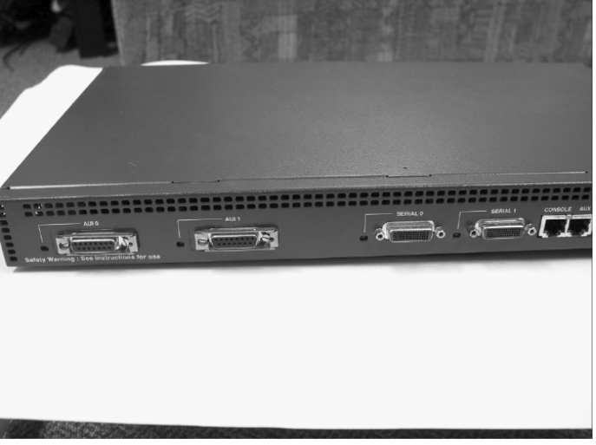
A router with two LAN ports - AUI0 and AUI1
and two WAN ports – Serial 0 and Serial1

Slide 106
Gateway
Gateway – A gateway, as the name suggests, is a passage to connect two networks together that may work upon different networking models. They basically works as the messenger agents that take data from one system, interpret it, and transfer it to another system. Gateways are also called protocol converters and can operate at any network layer. Gateways are generally more complex than switch or router.
Brouter – It is also known as bridging router is a device which combines features of both bridge and router. It can work either at data link layer or at network layer. Working as router, it is capable of routing packets across networks and working as bridge, it is capable of filtering local area network traffic.

Slide 107
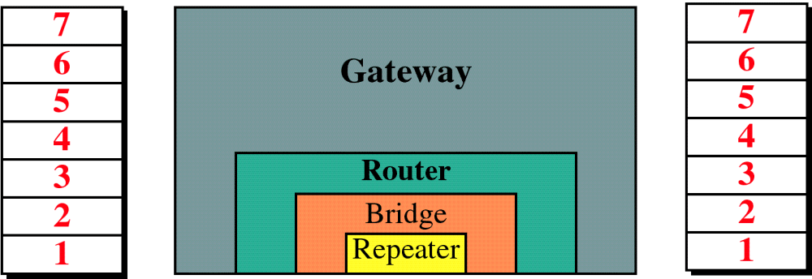
Connecting Devices and
the OSI Model

Slide 108
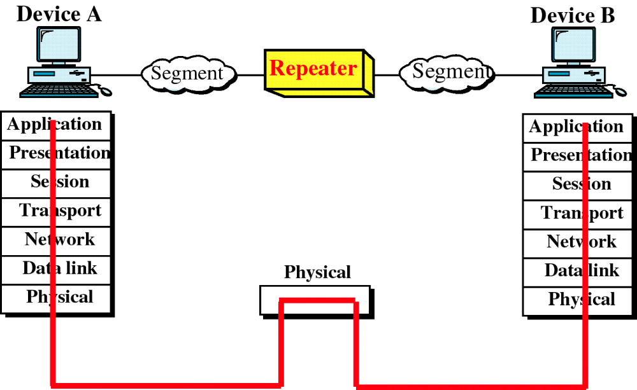
Repeater and OSI Model

Slide 109
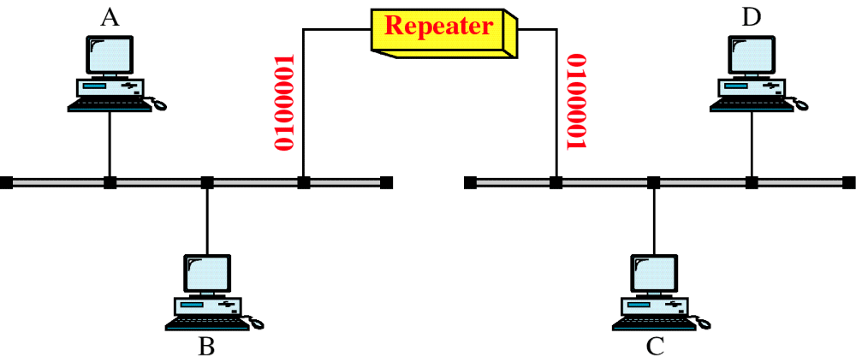
A Repeater

Slide 110
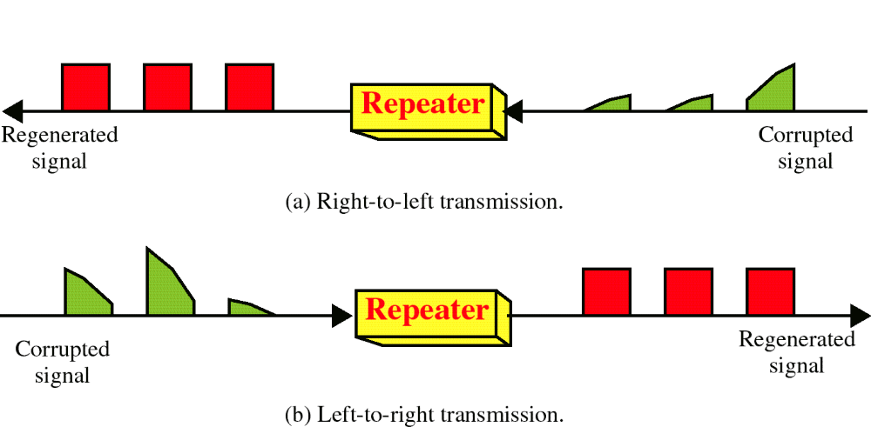
Function of a Repeater

Slide 111
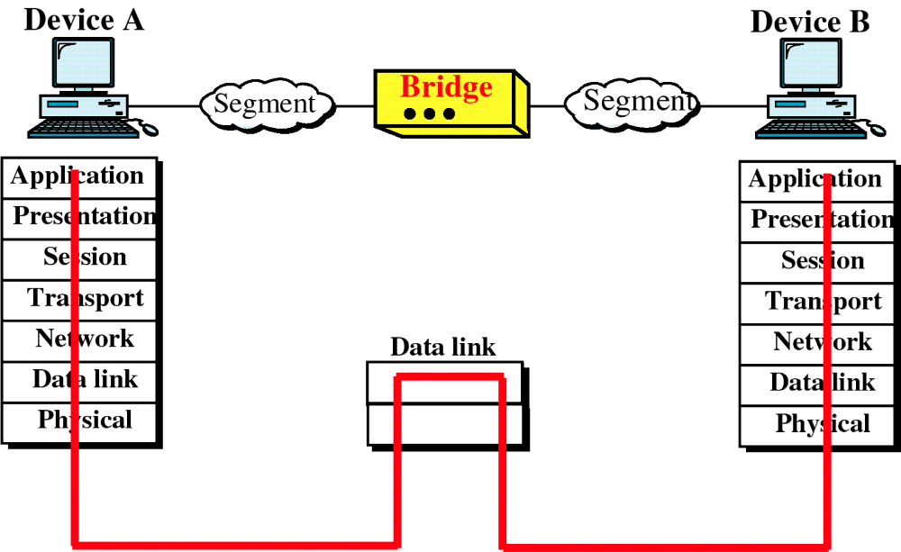
Bridge and the OSI Model

Slide 112
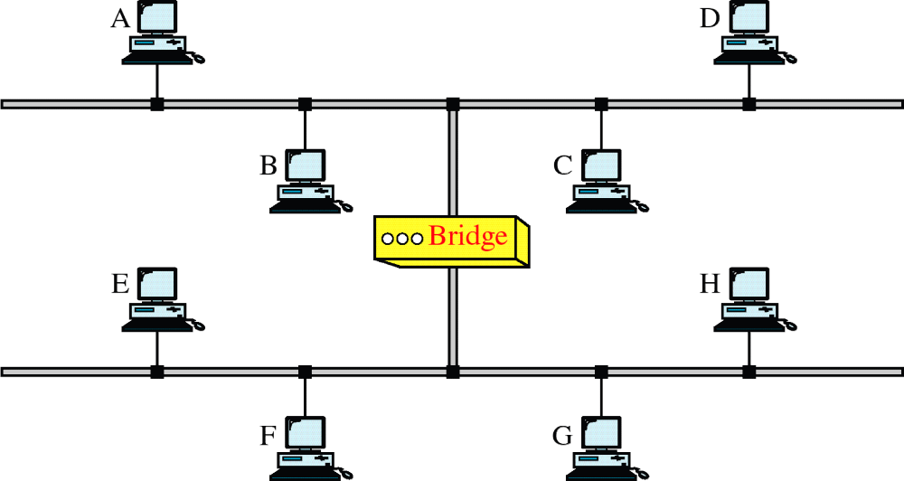
A Bridge

Slide 113
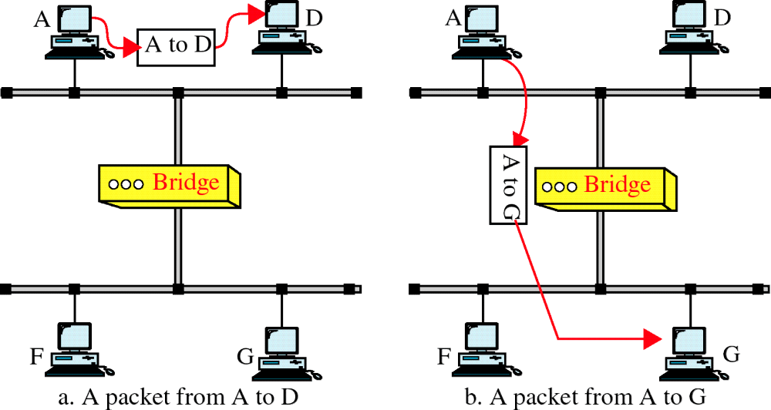
Function of a Bridge

Slide 114
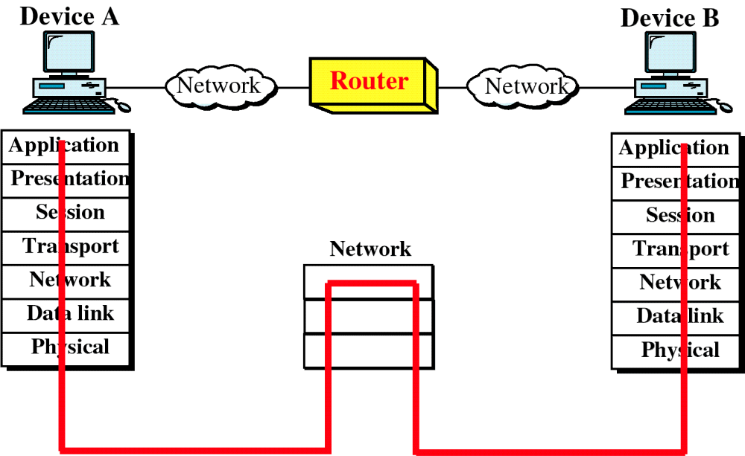
Router and the OSI Model

Slide 115
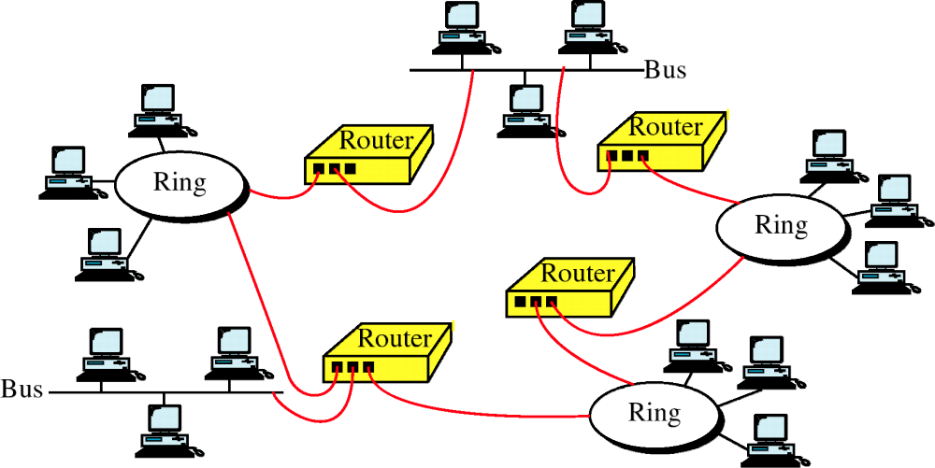
Routers in an Internet

Slide 116
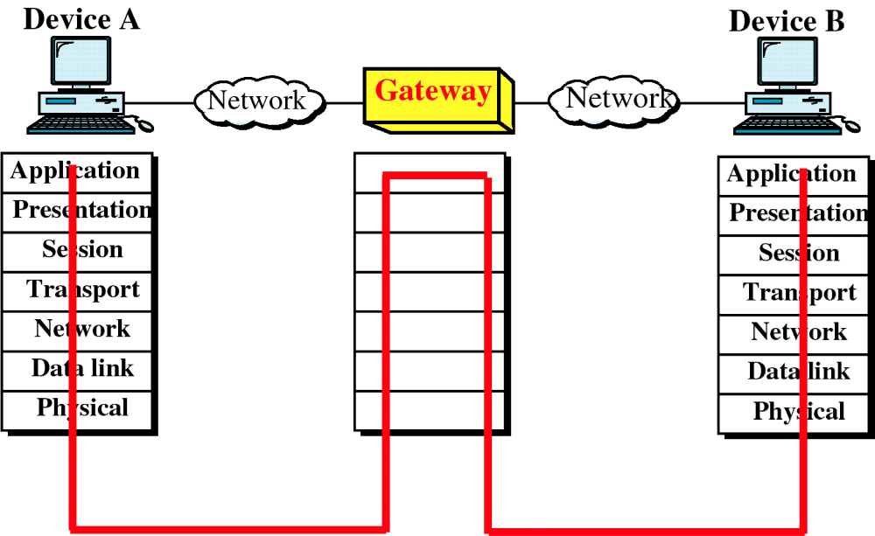
Gateway and the OSI Model

Slide 117
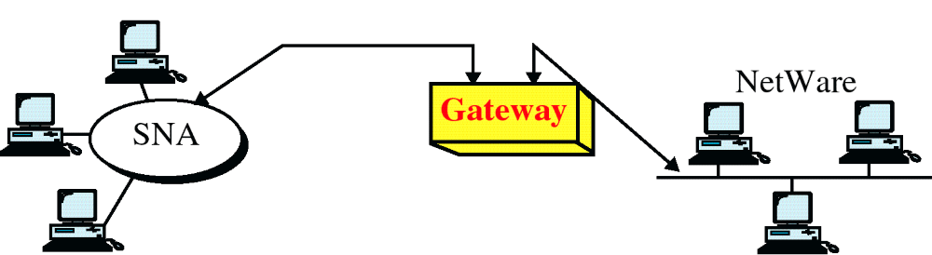
A Gateway

Slide 118
Network Hardware (1)
Personal area networks
Local area networks
Metropolitan area networks
Wide are networks
The internet
Computer Networks, Fifth Edition by Andrew Tanenbaum and David Wetherall, © Pearson Education-Prentice Hall, 2011

Slide 119
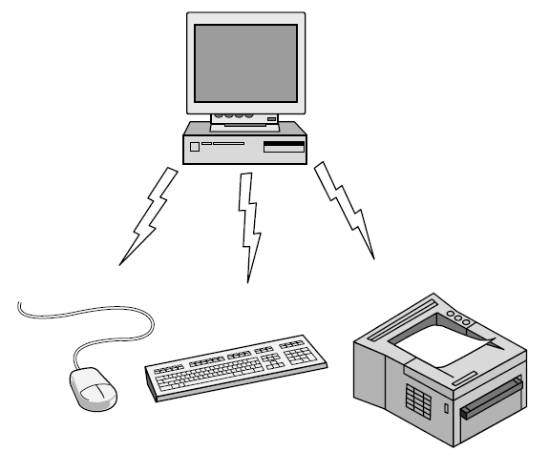
Personal Area Network
Bluetooth PAN configuration

Slide 120
Local Area Network
Privately owned network
They span within a single building or campus of up to few kilometers in size.
Widely used to connect personal computers and work stations in company offices to share resources and exchange information.
LANs are distinguished by other technologies by their 3 characteristics
Size
Transmission Technology
Topology

Slide 121
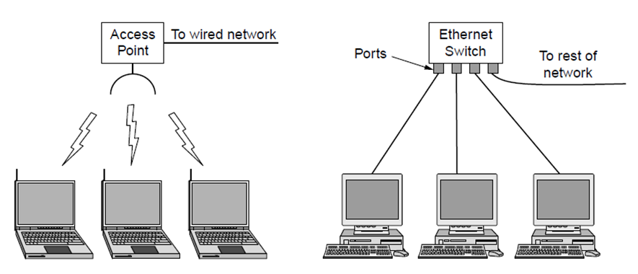
Local Area Networks
Wireless and wired LANs. (a) 802.11. (b) Switched Ethernet.

Slide 122
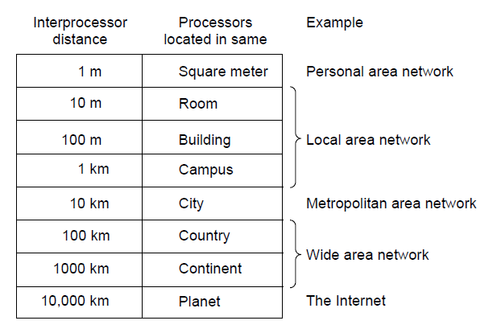
Network Hardware (2)
Classification of interconnected processors by scale.

Slide 123
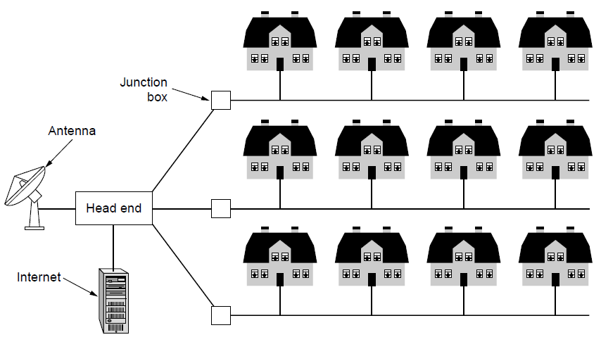
Metropolitan Area Networks
A metropolitan area network based on cable TV.

Slide 124
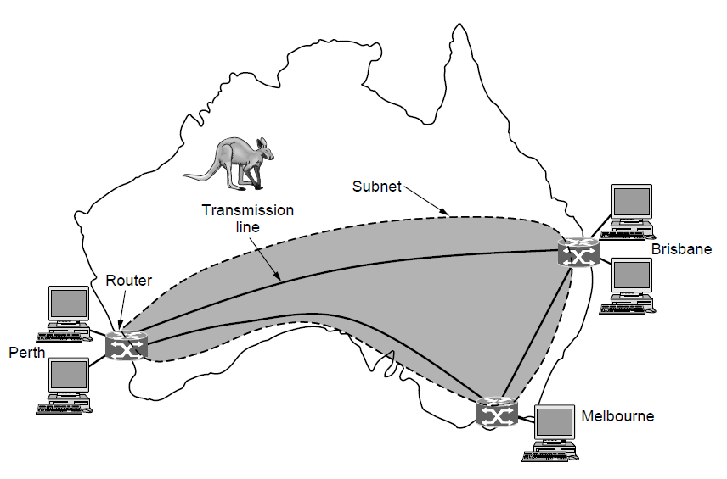
Wide Area Networks (1)
WAN that connects three branch offices in Australia

Slide 125
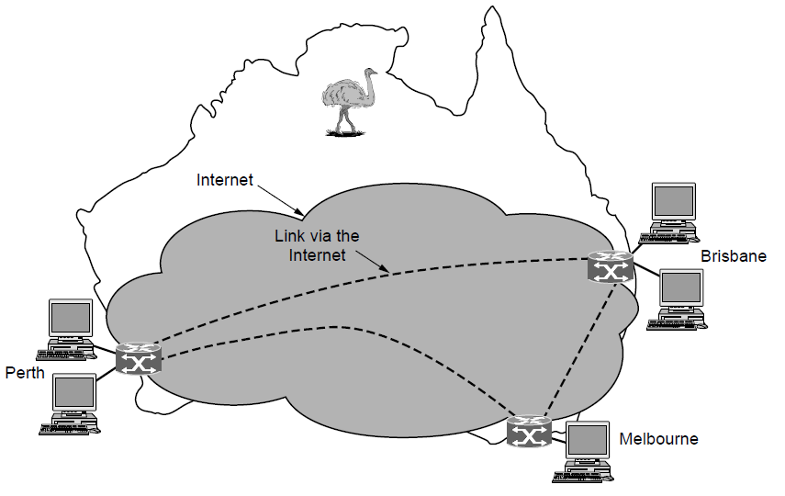
Wide Area Networks (2)
WAN using a virtual private network.

Slide 126

An isolated LAN connecting 12 computers to a hub in a closet
Notes:
1.#

Slide 127

WANs: a switched WAN and a point-to-point WAN
Notes:
1.#

Slide 128

A heterogeneous network made of four WANs and two LANs
Notes:
1.#

Slide 129
THE INTERNET
The Internet has revolutionized many aspects of our daily lives. It has affected the way we do business as well as the way we spend our leisure time. The Internet is a communication system that has brought a wealth of information to our fingertips and organized it for our use.
Notes:
1.#

Slide 130

Hierarchical organization of the Internet
Notes:
1.#

Slide 131
The End

